Slide 1
Introduction to R
Mrinmayi Kulkarni
Postdoctoral Research Fellow, Olsen and Buchsbaum Labs
Workshop presented at Rotman Research Institute’s Summer Student Rounds – July 8, 2024

Slide 2
Our plan for today…
Section 1: Introduction to R: What, Why, How
Section 2: Variables + Data Types + Functions
Section 3: Data Wrangling
Select rows and columns
Summarise data
Plotting
Section 4: Control Flow
if/else statements
Loops
Section 5: Best Practices
Section 6: Debugging + Getting Help

Slide 3
Introduction to R
What?
Programming language for
Statistical computing
Data visualization
Also… making web-based dashboards (look up “RShiny”)
Why?
Free!!
Open-source
Community contributions
How?
Install R
Install Rstudio (an R IDE)

Slide 4
Our plan for today…
Section 1: Introduction to R: What, Why, How
Section 2: Variables + Data Types + Functions
Section 3: Data Wrangling
Select rows and columns
Summarise data
Plotting
Section 4: Control Flow
if/else statements
Loops
Section 5: Best Practices
Section 6: Debugging + Getting Help

Slide 5
Concepts are applicable in most programming languages
Syntax will differ across languages

Slide 6
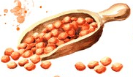



What are variables?
Containers of information with a label
Creates a container
> x = 1
> k = "text"
> my_name = "Mrinmayi Kulkarni"
> x
[1] 1
> y = 3
> x + y
[1] 4
> z = x + y
> z
[1] 4
=
Information
Label
coffee
lentils
cherries
Pantry
Fruit
Breakfast

Slide 7
Why use variables?
Information is not always known
Same information is used multiple times
> TestData = read.csv("~/Desktop/My_Project/ Experiment1/Data/Test.csv")
> EncodeData = read.csv("~/Desktop/My_Project/ Experiment1/Data/Encode.csv")
> DemoData = read.csv("~/Desktop/My_Project/ Experiment1/Data/Demographics.csv")
> DataPath = "~/My_Project/Experiment1/ Data/"
> TestData = read.csv(paste0(DataPath, "Test.csv"))
> EncodeData = read.csv(paste0(DataPath, "Encode.csv"))
> DemoData = read.csv(paste0(DataPath, "Demographics.csv"))
> TestData = read.csv("Test.csv")
> MeanRT = mean(TestData$RT)
> MeanRT
[1] 435.1282
> TestData = read.csv("~/Desktop/My_Project/ Experiment1/Data/Test.csv")
> EncodeData = read.csv("~/Desktop/My_Project/ Experiment1/Data/Encode.csv")
> DemoData = read.csv("~/Desktop/My_Project/ Experiment1/Data/Demographics.csv")
> DataPath = "~/Desktop/My_Project/ Experiment1/Data/"
> TestData = read.csv(paste0(DataPath, "Test.csv"))
> EncodeData = read.csv(paste0(DataPath, "Encode.csv"))
> DemoData = read.csv(paste0(DataPath, "Demographics.csv"))
> TestData = read.csv("~/My_Project/ Experiment1/Data/Test.csv")
> EncodeData = read.csv("~/My_Project/ Experiment1/Data/Encode.csv")
> DemoData = read.csv("~/My_Project/ Experiment1/Data/Demographics.csv")
> DataPath = "~/My_Project/Experiment1/ Data/"
> TestData = read.csv(paste0(DataPath, "Test.csv"))
> EncodeData = read.csv(paste0(DataPath, "Encode.csv"))
> DemoData = read.csv(paste0(DataPath, "Demographics.csv"))

Slide 8
What are the data types in R?
Text/Strings (character)
Numbers (numeric)
> My_Text = "This is some text"
> My_Letter = "a"
> My_Numeric = 2
> My_Numeric
[1] 2
> My_Decimal = 2.321
TRUE/FALSE (logical)
Whole numbers (integer)
Complex numbers (complex)
> My_True = TRUE
> My_False = FALSE
> My_True
[1] TRUE
> 1 > 2
[1] FALSE
> My_Integer = 2L
> My_Integer
[1] 2
> My_ComplexNum = 1+3i
> (1+1i) + (4+3i)
[1] 5+4i

Slide 9
Why worry about data types?
Certain operations require certain data types.
Not paying attention to data types can lead to unintended consequences:
Certain operations might cause R to throw an error.
Certain operations might force a change in data types.
Especially important when dealing with data structures!
> x = 3
> y = 2
> x + y
[1] 5
> z = "Some text"
> x + z
Error in x + z : non-numeric argument to binary operator
> paste0(z, x)
[1] "Some text3"

Slide 10
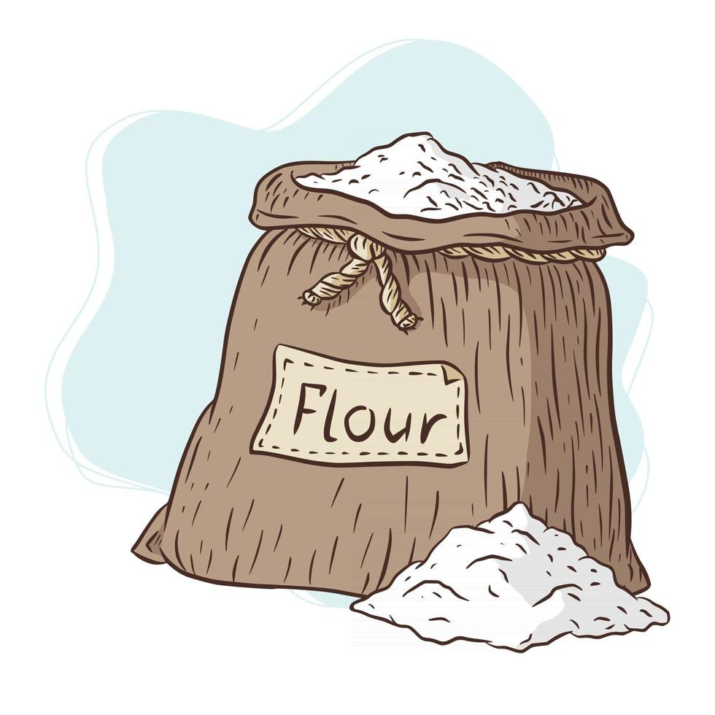

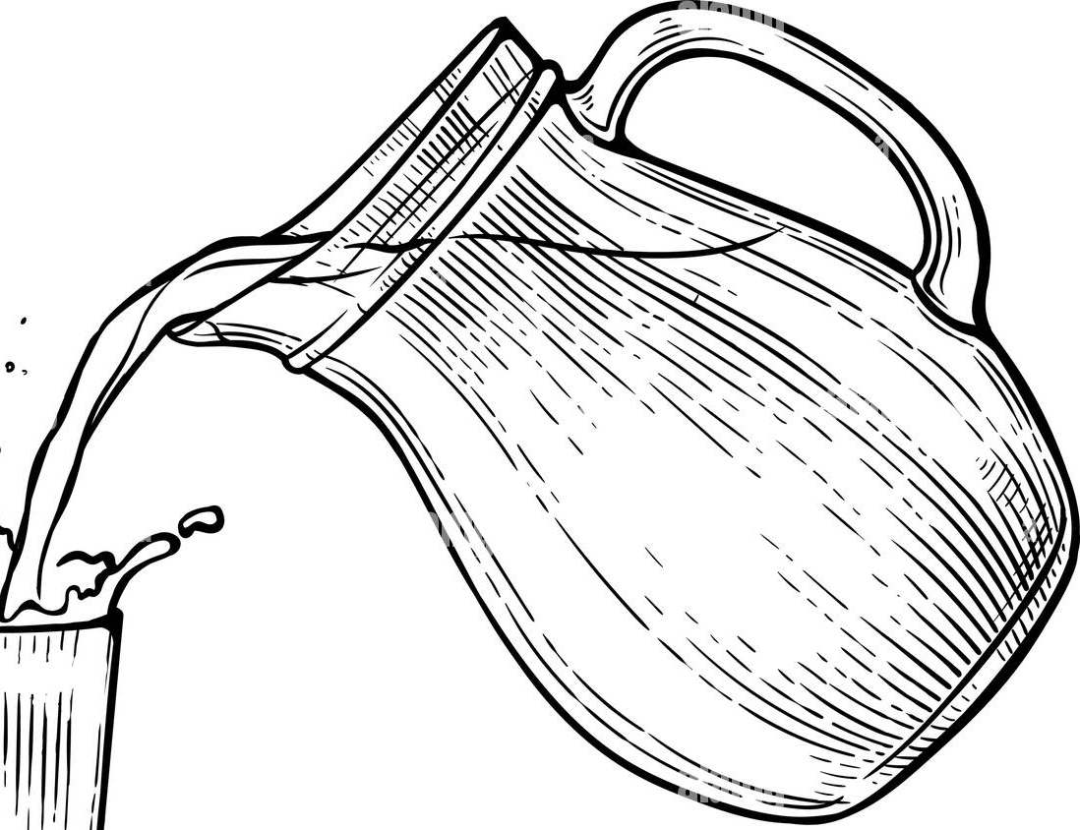
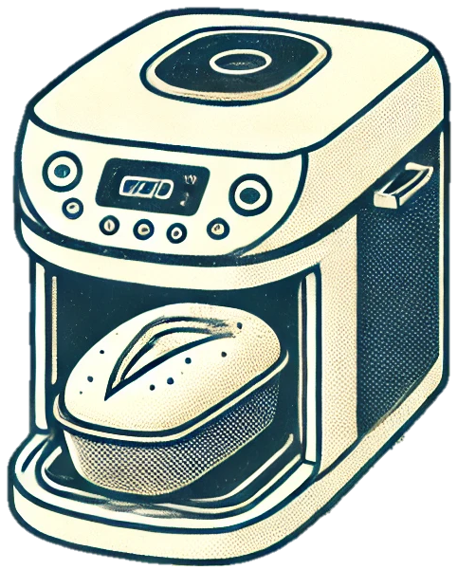
What are functions?
Set of instructions to perform operations
Parameters
> x = 1
> y = 2
> z = 3
> sum(x, y, z)
[1] 6
> k = "a"
> sum(x, y, z, k)
Error in sum(x, y, z, k) : invalid 'type' (character) of argument
=
Function

Slide 12
Our plan for today…
Section 1: Introduction to R: What, Why, How
Section 2: Variables + Data Types + Functions
Section 3: Data Wrangling
Select rows and columns
Summarise data
Plotting
Section 4: Control Flow
if/else statements
Loops
Section 5: Best Practices
Section 6: Debugging + Getting Help

Slide 13
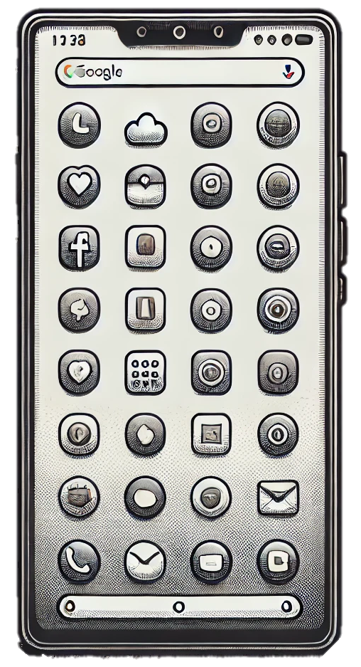
Side quest: Packages
> install.packages("dplyr")
> library(dplyr)
> ls("package:dplyr")
[1] "%>%" "across" "add_count" [4] "add_count_" "add_row" "add_rownames" [7] "add_tally" "add_tally_" "all_equal”...
Check the weather
Check
directions
Play
Pokemon Go
Make a to-do list

Slide 14
Data structures in R
Vectors
1-D array of elements
All elements have to be of the same type (e.g., numeric, character, etc.)
Matrix
2-D
All elements have to be of the same type (e.g., numeric, character, etc.)
Data frames
Like a matrix, but
List
No restrictions on data types
No restrictions on dimensions

Slide 16
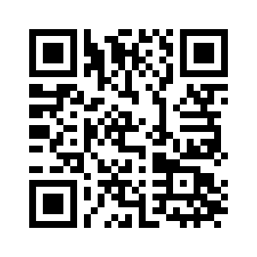
Download the scripts
https://github.com/mrinmayik/IntroToR

Slide 17
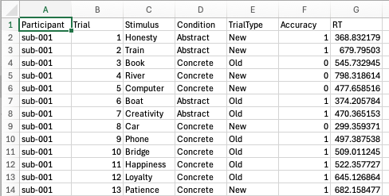
Our experiment
Press “B” for Old
Press “N” for New
Respect
Dog
Freedom
Creativity
Lamp

Slide 18
Our plan for today…
Section 1: Introduction to R: What, Why, How
Section 2: Variables + Data Types + Functions
Section 3: Data Wrangling
Select rows and columns
Summarise data
Plotting
Section 4: Control Flow
if/else statements
Loops
Section 5: Best Practices
Section 6: Debugging + Getting Help

Slide 19
Control flows
If/Else Statement
For loop
y = 3
y = 1
1 a <- "Hello"
2 b <- "World"
3 my_name = "Mrinmayi Kulkarni"
4 x <- 2
5 y <- 4
6 z = x + y
7 paste(a, b, x)
1 Sub1 <- read.csv("sub-001_TestData.csv")
2 Sub2 <- read.csv("sub-002_TestData.csv")
3 Sub3 <- read.csv("sub-003_TestData.csv")
4 Sub4 <- read.csv("sub-004_TestData.csv")
5 Sub5 <- read.csv("sub-005_TestData.csv")
...
Is y an even number?
Is y less than 5?
y = 2
y = 3
I only want to execute this if y is an even number
No
Yes!
No
Yes!
Don’t execute z = x + y
Execute z = x + y
Stop running
Execute read.csv(paste0( "sub-00", y, "_TestData.csv"))

Slide 21
Our plan for today…
Section 1: Introduction to R: What, Why, How
Section 2: Variables + Data Types + Functions
Section 3: Data Wrangling
Select rows and columns
Summarise data
Plotting
Section 4: Control Flow
if/else statements
Loops
Section 5: Best Practices
Section 6: Debugging + Getting Help

Slide 22
Best Practices
Use variables…
… with descriptive variable names
Write scripts instead of running individual commands
Comment your code – for the sake of future you!
Make sure data and files are named and organised well

Slide 23
Our plan for today…
Section 1: Introduction to R: What, Why, How
Section 2: Variables + Data Types + Functions
Section 3: Data Wrangling
Select rows and columns
Summarise data
Plotting
Section 4: Control Flow
if/else statements
Loops
Section 5: Best Practices
Section 6: Debugging + Getting Help

Slide 24
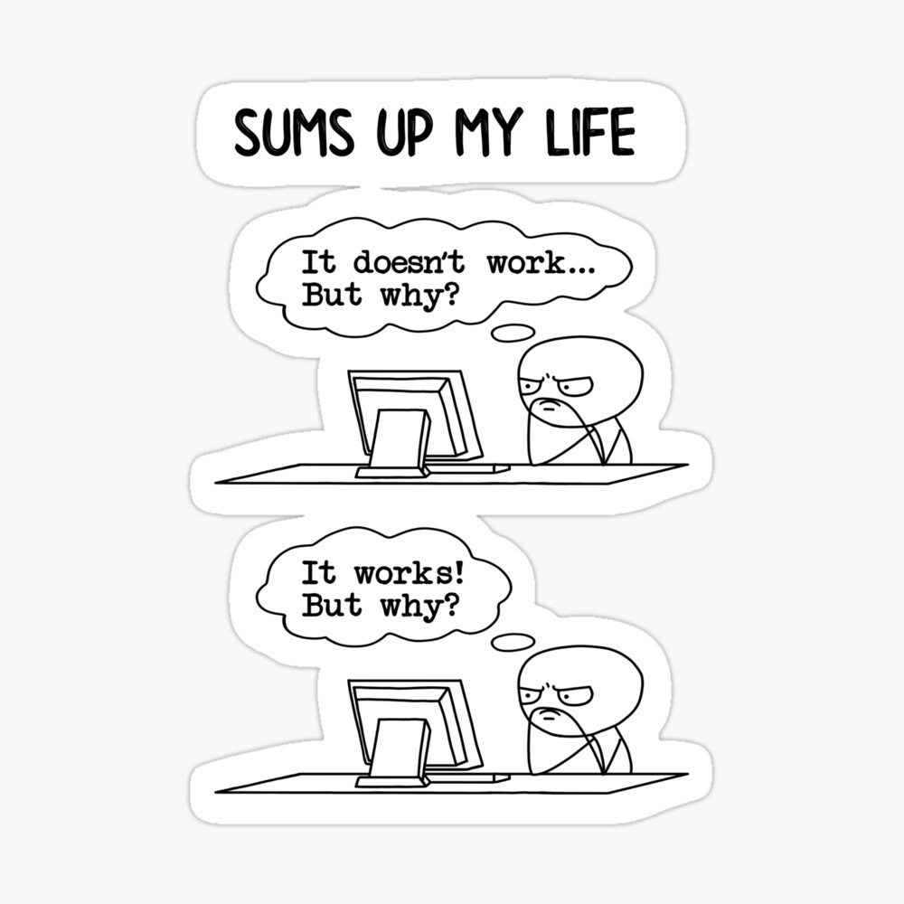
Debugging + Getting Help
Within R
Using ??
Good ol’ Google!!
Function help pages
Use keywords
Paste errors
StackOverflow
ChatGPT
Describe your problem in detail
Give context
CHECK.THE.SOLUTION. THOROUGHLY!!

Slide 25
Resources
University of Glasgow course on reproducible research in R:
https://psyteachr.github.io/
YaRrr: Pirate’s guide to R
https://bookdown.org/ndphillips/YaRrr/
Learning Statistics with R
https://bookdown.org/ekothe/navarro26/
Data Science Learning Community
https://github.com/rfordatascience
Get your hands on some data :)

Slide 26
Thank you! Questions?
Email: mkulkarni@research.baycrest.org
Twitter X: @mrinmayi17
LinkedIn: mrinmayi-kulkarni

